Slide 1
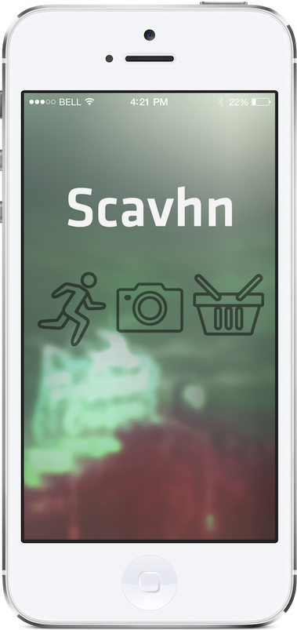

Scavhn Scavenger Hunt App.
Scav = Slang for Scavenger Hunt
hn = Hunt!

Slide 2
Overview
Players are given Scavs with 3 different levels to choose from: Beginner (Vulture), Intermediate (Owl), Expert (Raccoon)
Player selects a Scav and clicks “Begin Game” to start the clock.
On start, the player is presented with a list of items to find and take pictures of. The app uses Geolocation to help verify the item they are taking a picture of is the item they are looking for. If they are taking a picture of an item that is no where near it, Scavhn will let the player know, and ask to try again.
When all items are found, Scavhn notifies the user that the Scav is complete. If the player doesn’t find all of the items in time, Scavhn notifies the user, locks down any further play and returns him/her to the home screen.

Slide 3
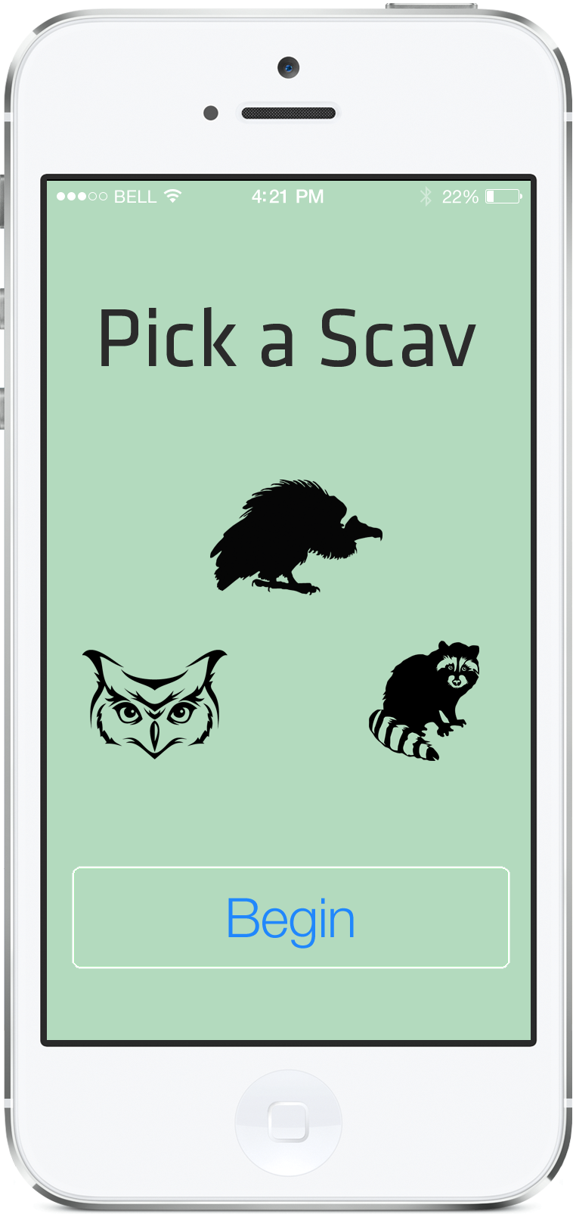
Home Screen
Player selects a Scav:
Vulture – Beginner
Owl – Intermediate
Racoon – Expert
Upon selection, the selected Scav
Is highlighted.
The Player then taps Begin to start.

Slide 4
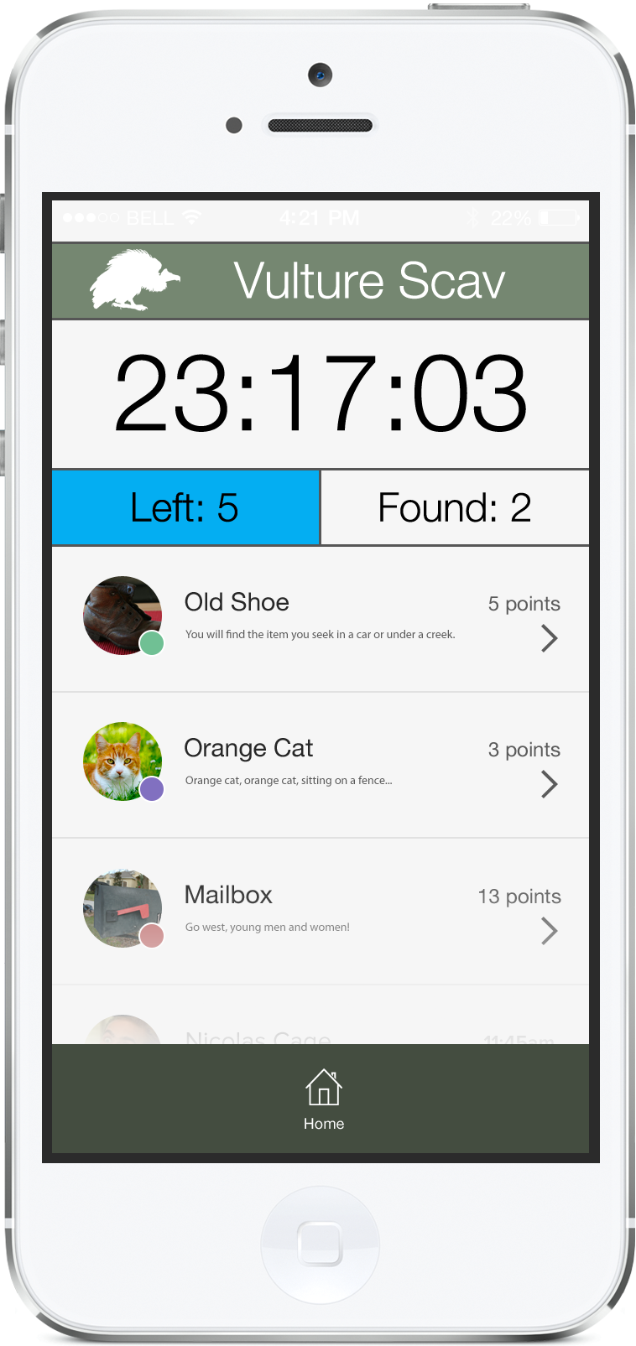
Scav Item Screen
Game level player is currently in
Running Timer
Game Status: Items left to find
Game Status: Items found so far
Scav Items to look for. Colored dots denote point value. Scav items come with a proverb-like hint that clues the player in on where to start looking.
Return home. This quits the
player out of the current game.

Slide 5
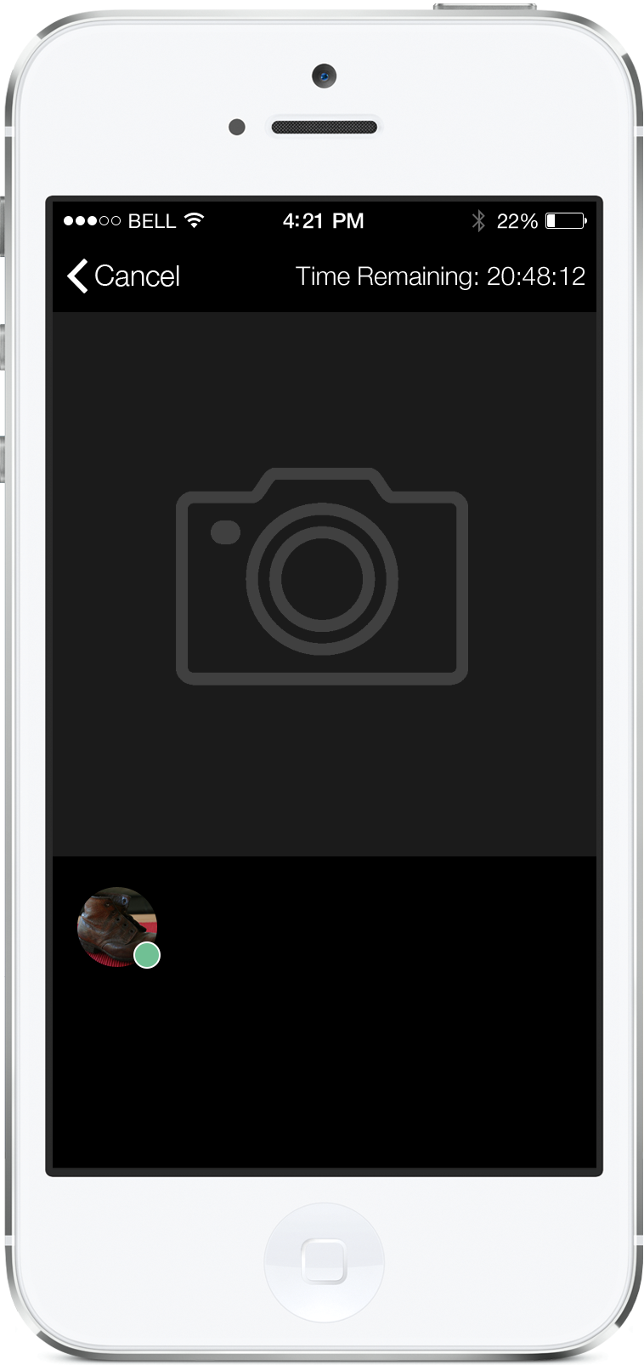
Scav Camera Screen – Initial View
Cancel returns
player to
Item view.
Current Scav Timer
Tapping on the camera area launches the
Safari camera for taking a picture of the item
Item the player is looking for is displayed for
comparison

Slide 6
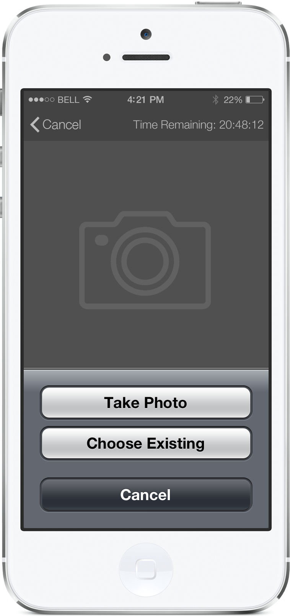
Scav Camera Screen – Camera Prompt (Safari HTML5 media capture)
Player is prompted to jump out to
Safari’s camera

Slide 7
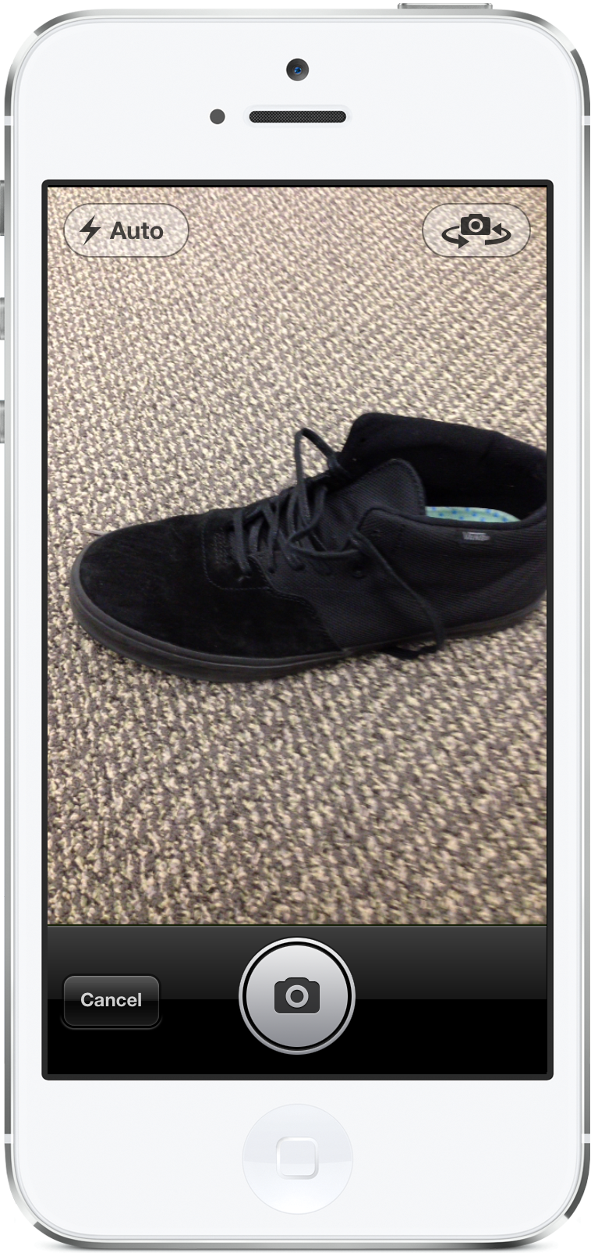
Scav Camera Screen – Take Picture (Safari HTML5 media capture)
Player takes a picture of item
found.

Slide 8
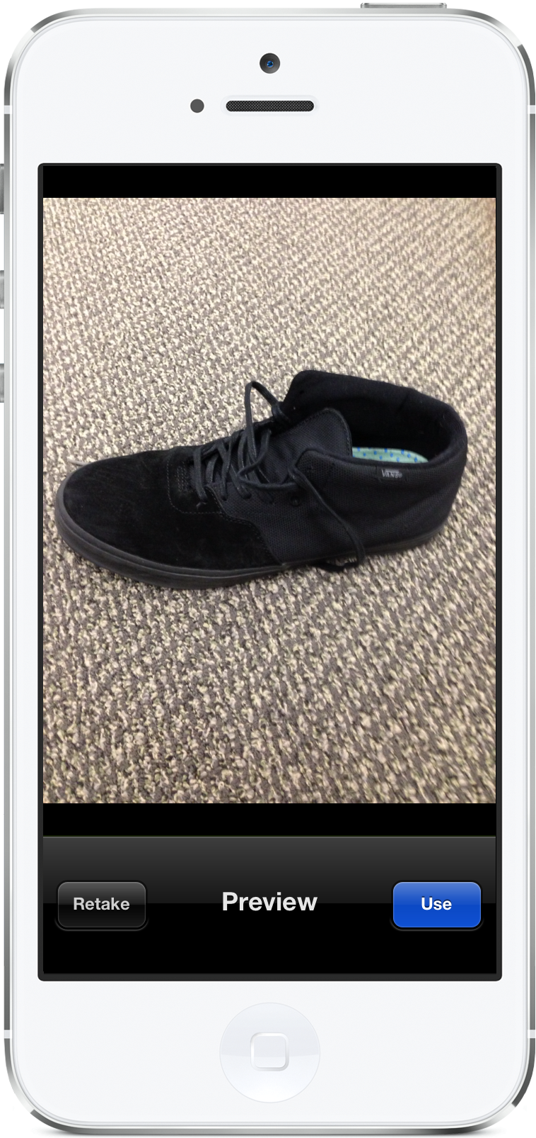
Scav Camera Screen – Confirm Picture Safari HTML5 media capture)
Player is prompted to confirm
whether to use the picture taken.

Slide 9
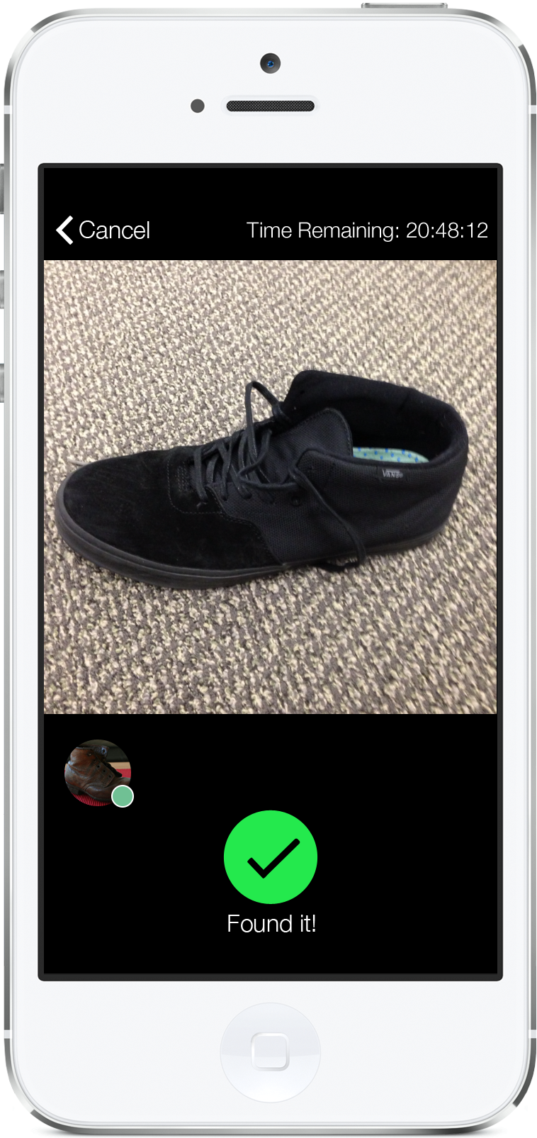
Scav Camera Screen – Verification View – Item Found
Scavhn uses Geolocation to verify
that the picture taken is in near
proximity to the item the Player has
been tasked with finding. If it is, the
“Found it!” button appears.
Tapping on this button returns the
player to the item view to continue
Play.

Slide 10
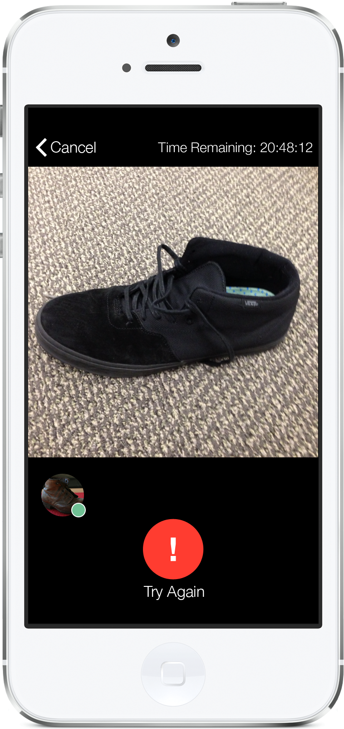
Scav Camera Screen – Verification View - wrong item
If the location of found item doesn’t
match Scavhn’s Geolocation info for
the Scav item, user receives a prompt
to try again.
Tapping on the Try Again button returns
The Camera screen to its initial view.

Slide 11
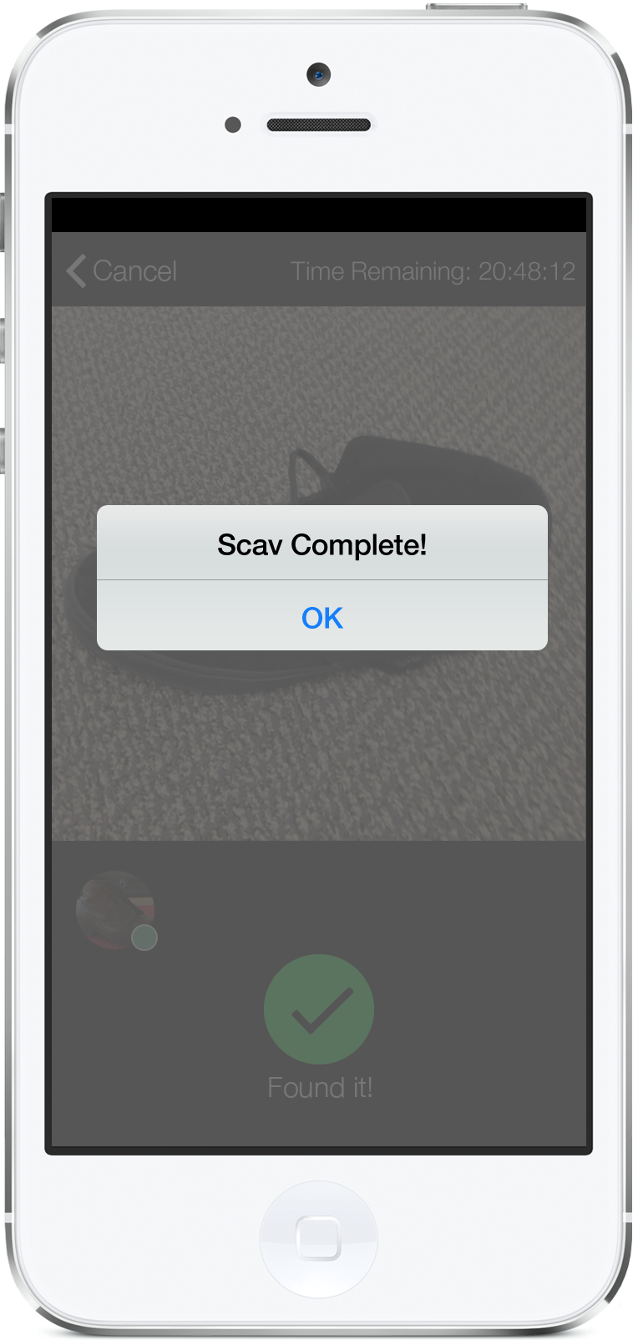
Scav Game Over Modal
Once all Scav items are found,
the player receives a dialog notifying
them that the Scav has been completed
successfully.
Tapping on OK returns the player to the
Home screen.

Slide 12
Scav Time’s Up Modal
Once all Scav items are found,
the player receives a dialog notifying
them that the Scav has been completed
successfully.
Tapping on OK returns the player to the
Home screen.

